Slide 1
TIMBER-V: Tag-Isolated Memory Bringing Fine-grained Enclaves to RISC-V
Samuel Weiser Mario Werner
Ferdinand Brassery Maja Malenko
Stefan Mangard Ahmad-Reza Sadeghiy

Slide 2
Design Goals
G1 Security
(i) strong memory isolation (ii) secure entry points
(iii) secure communication (iv) attestation and sealing
G2 Flexibility
(i) fine-grained (ii) dynamically reconfigurable isolation boundaries
G3 Compatibility
Support existing os and apps without modification
G4 Low Overhead
(i) cost of tagged memory (ii) performance overhead of switching security domains
G5 Real-time
* TIMBER-V does not prevent software side-channel attacks.

Slide 3
Tag Isolation Policy
Tagged Memory
Hardware
Tag-aware Instruction
Memory Protected Unit
Trusted OS Services
TIMBER-V
Software
Trusted Enclave Services
Code Transformation
Others
Memory Interleaving

Slide 4
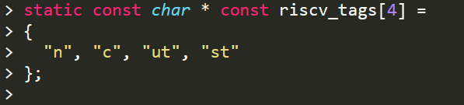
Tag Isolation Policy
Using two-bit tag per 32-bit memory word (goal G2).
Untrusted memory (N-tag), trusted user memory (TU-tag), trusted supervisor memory (TS-tag), secure entry points (TC-tag).
The only way to enter T-domains is by fetching code tagged with TC-tag. When fetching N-tagged memory, the CPU leaves trusted execution and switches back to the N-domains.

Slide 5
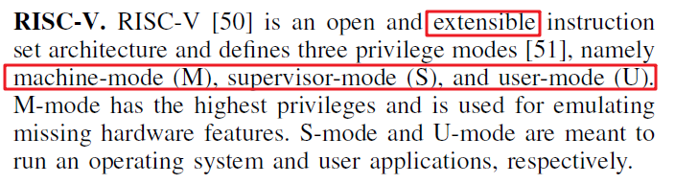
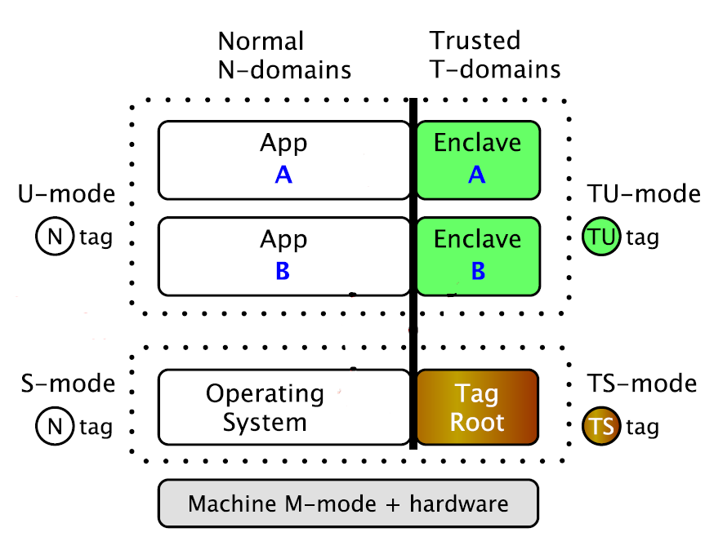
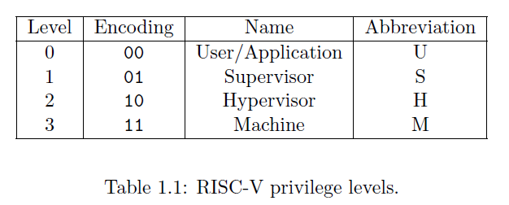
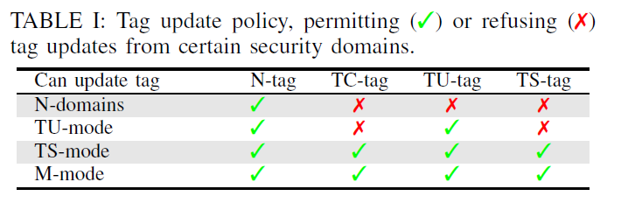
Tag Isolation Policy
At any time, a RISC-V hardware thread (hart) is running at some privilege level encoded as a mode in one or more CSRs (control and status registers).
Notes:
TIMBER-V supports four security domains.
The operating system and apps live in the normal N-domains, which are considered untrusted. The N domains support the traditional split between user (U-mode) and supervisor (S-mode) and allow existing code to run without modification (goal G3).
Sensitive memory is protected via fine-grained memory tagging, which creates islands of trusted memory inside the N-domains.
Trusted user mode (TU-mode) can be leveraged for isolated execution environments, called enclaves.
Moreover, trusted supervisor mode (TS-mode) allows to run a trust manager like TagRoot, augmenting the untrusted operating system with trusted services.
To achieve this, TIMBER-V combines security domain isolation with MPU based process isolation. The trusted domains are protected by a strict tagged memory policy, which we denote as tag isolation. Individual processes or enclaves are protected via MPU isolation. Memory accesses are only permitted if both mechanisms agree . This allows a variety of different programming models, as demanded by goal G2. For example, we achieve TrustZone s [3] security split via memory tags, however with much finer and highly dynamic isolation boundaries. Also, TIMBER-V can embed enclaves directly in user processes, as done in Intel SGX-like designs [37], however, again with the benefits of tagged memory.

Slide 6
Fast Domain Transitions
Both TU-mode and TS-mode use the same TC-tag to specify secure entry points.
Prevent by constraining horizontal transitions to MPU regions of the same privilege mode: TUenter is only allowed for user mode MPU slots, while TSenter can only target MPU slots marked for TS-mode. TS-mode slots cannot be manipulated from the untrusted OS.
Vertical transitions are in fact syscalls. In the N domains, apps can issue syscalls to the operating system. In the T-domains, enclaves can request TagRoot services via Tsyscalls.
To cleanly separate vertical transitions, TIMBER-V adds a separate trusted syscall (trap) handler.
Notes:
If not cleanly separated, this would allow confusion attacks between TUenter and TSenter. For example, an attacker could spawn a malicious enclave (TU-mode). While this malicious
enclave normally cannot access other benign enclaves, the attacker could invoke the enclave via a TSenter from S-mode rather than a TUenter from U-mode. Hence, the malicious
enclave would execute in higher-privileged TS-mode, thus undermining all of TagRoot’s security guarantees. We prevent such attacks by constraining horizontal transitions to MPU
regions of the same privilege mode: TUenter is only allowed for user mode MPU slots, while TSenter can only target MPU slots marked for TS-mode. TS-mode slots cannot be
manipulated from the untrusted OS. Again, this resembles supervisor mode execution prevention [29].

Slide 7
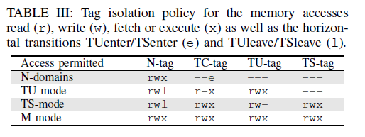
MPU Design
Relying on tag isolation for process isolation would require large tags.
Each MPU slot holds: base and bound information together with rwx access permissions, a TU and a TS flag.
Slot with TU are shared between enclaves and untrusted apps.
Slots with TS cannot be manipulated from untrusted code and are used to distinguish TSenter from TUenter.
Only TagRoot can enable these flags.
Untrusted operating system can
overwrite TU slots.

Slide 8
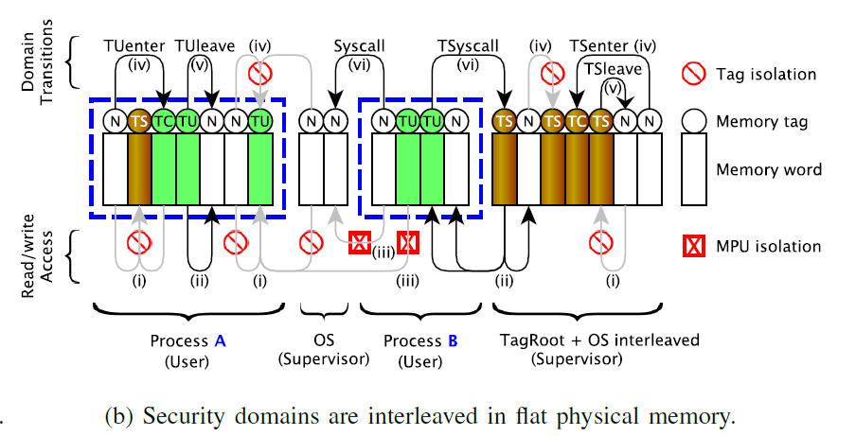
Tag Isolation Policy
Notes:
At every memory access, a hardware tag engine ensures that trusted memory cannot be accessed from untrusted code (i). Moreover, trusted supervisor memory (TS-tag) used for TagRoot cannot be accessed from enclaves (TU-tag). In contrast, trusted domains can access lesser trusted memory (ii), as long as the MPU isolation policy allows it.

Slide 9
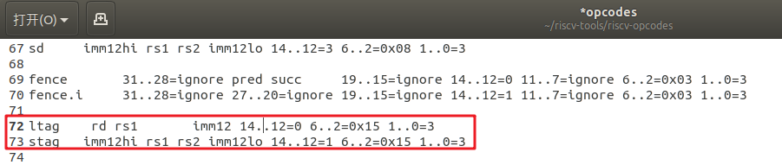
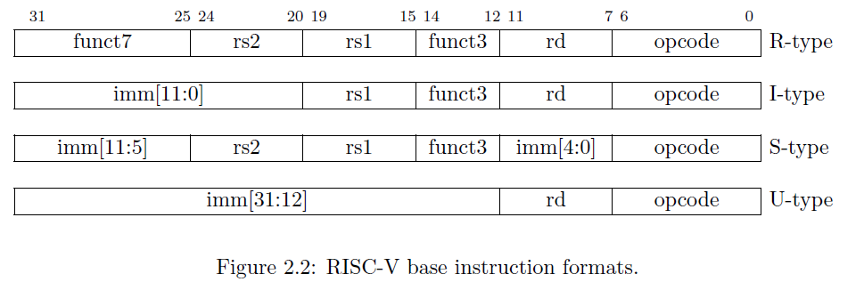
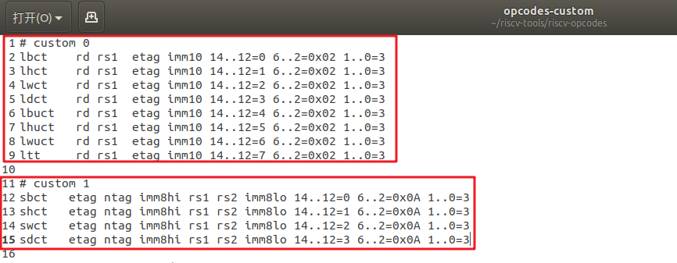
Tag-aware Instructions

Slide 10
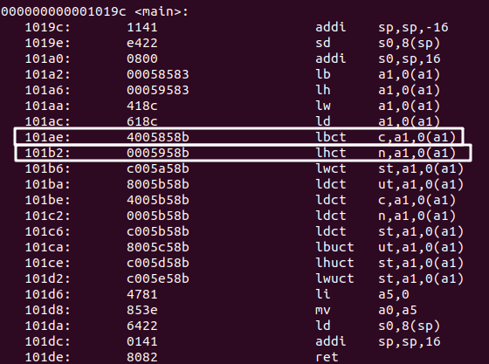
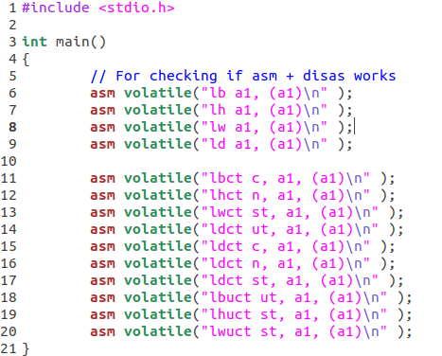
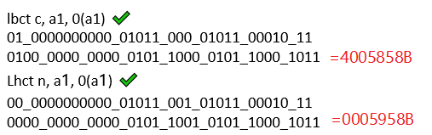
Tag-aware Instructions

Slide 11
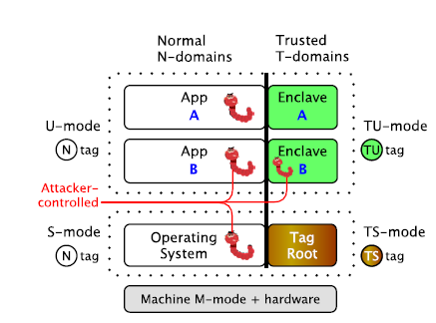
TagRoot: Trust Manager
Trusted OS Services
TagRoot
Trusted Enclave Services

Slide 12
Trusted OS Service
In-Process !
Enclave ManagementIn-Process
Create: Enclave Control Block(ECB)
create-enclave → add-region → add-data → add-entries → init enclave
Cleanup: destroy-enclave
Load: load to MPU slots → mark as runnable
Interrupt: save context → clear up → resume
transparent
Enclave Identity(EID)
Sequence of trusted OS services calls + their parament -------> EID
SHA256

Slide 13
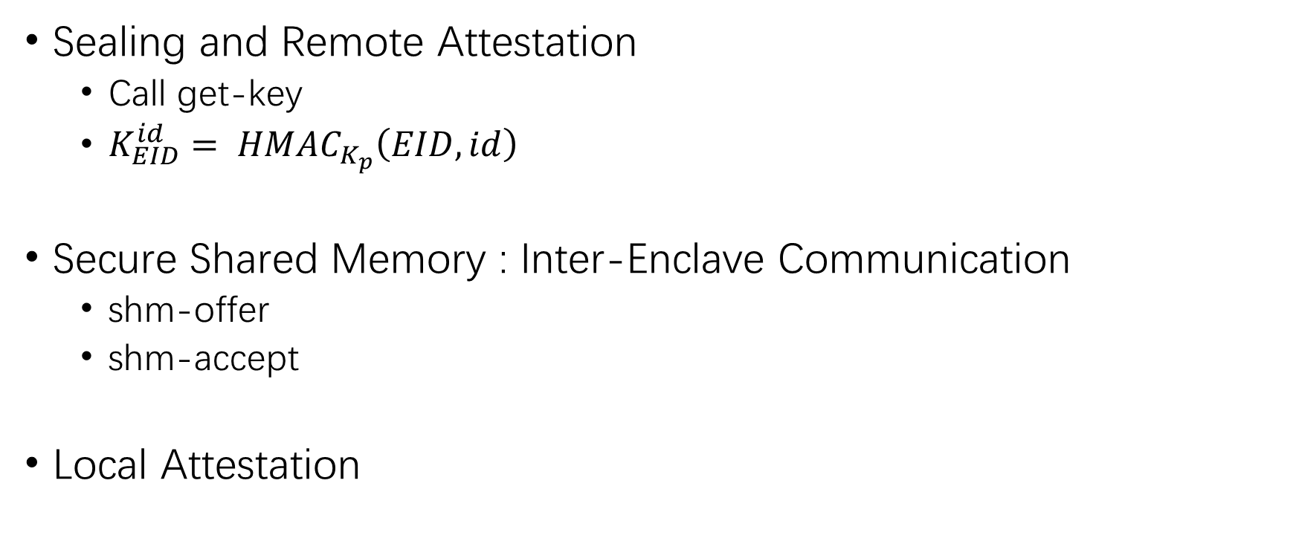
Trusted Enclave Services
Sealing and Remote Attestation
Call get-key
$K_{EID}^{id}= {HMAC}_{K_{p}}\left(EID, id\right)$
Secure Shared Memory : Inter-Enclave Communication
shm-offer
shm-accept
Local Attestation

Slide 14
Security Analysis
OS manipulation during loading? → load-time attestation(EID)
Interruption leakage? → secure interruption
Shared memory misuse? → mutual authentication
TagRoot’s integrity? → isolation via TS-tag

Slide 15
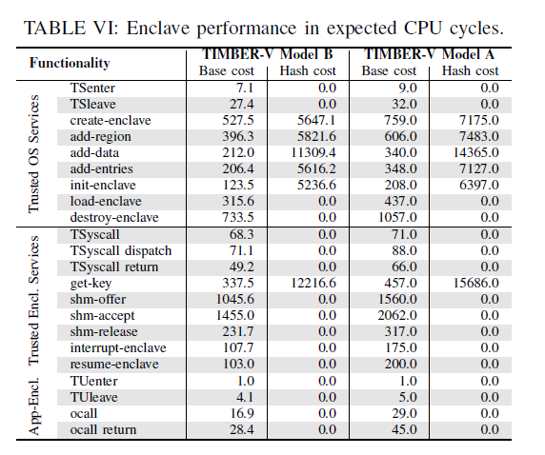
Evaluation
Performance
TagRoot code size

Slide 16
Dynamic Memory Management
Memory Interleaving
Minimize memory fragmentation
Keep data locality across security domain
Reduce management overhead
Heap Interleaving
Stack Interleaving
Notes:
它这个内存管理主要讲的就是这个Memory Interleaving，意义

Slide 17
Heap Interleaving
Alloc:
Trusted code ask untrusted code to allocate a chunk of memory on its heap (N-tag)
Trusted code claims the allocated memory chunk (N->TU/TS)
Free:
Trusted code simply clears it and reverts its tags and notifies the untrusted code to do the heap cleanup
User: keep a pointer to it inside protected enclave memory
Supervisor: when creating enclave, os allocates a trusted ECB
Notes:
Alloc & Free:
Trusted code set tag
Untrusted code set memory

Slide 18
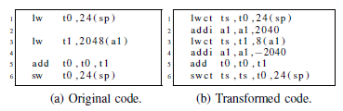
Stack Interleaving
Code Transformation
Compile source code to assembler code
Transform using a custom awk script

Slide 19
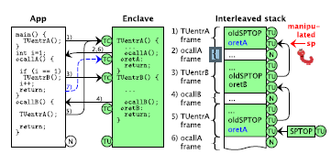
Stack Interleaving
Horizontally within supervisor mode
N-> Tsenter -> TS
Horizontally within user mode
N -> Tuenter -> TU
Vertical across Tsyscalls
TU -> TSyscall -> TS
Interrupt Handling
Unforgeable Header

Slide 20
Dynamic Memory Management
Granularity: Word
User <-> Memory Claim/Release by Check Store Instruction
Security Analysis:
Validity of the memory when claiming it
Validity during usage.
Notes:
避免覆盖信任的数据
检查SP没有被恶意的控制

Slide 21
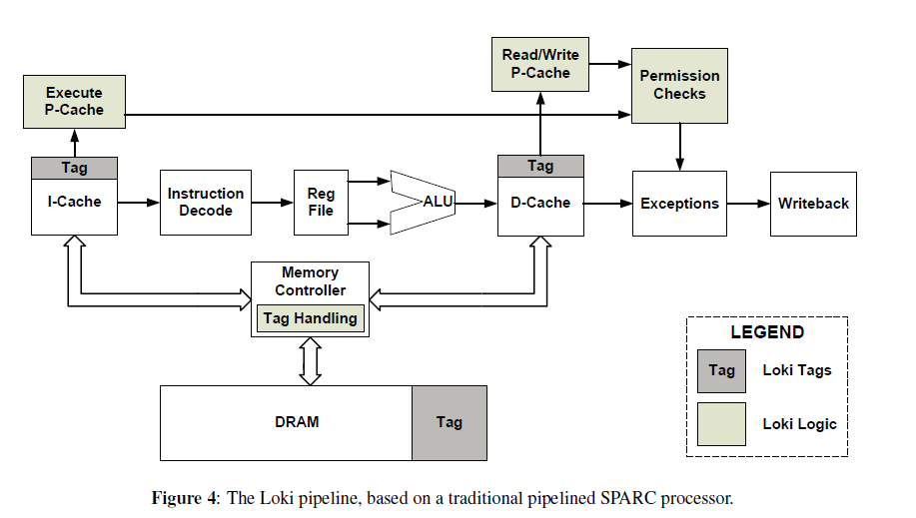
Tagged Memory
HDFI：Virtually extend each memory unit with an additional tag,
defined by data flow (2016)
Loki：Hardware Enforcement of Application Security Policies
Using Tagged Memory (2008)

